Slide 1


























Rate of growth of functions (order of growth)
Asymptotic Notation

Slide 2
























Time Complexity
Space Complexity

Slide 3





















Meaning of Asymptotic Analysis

Slide 4
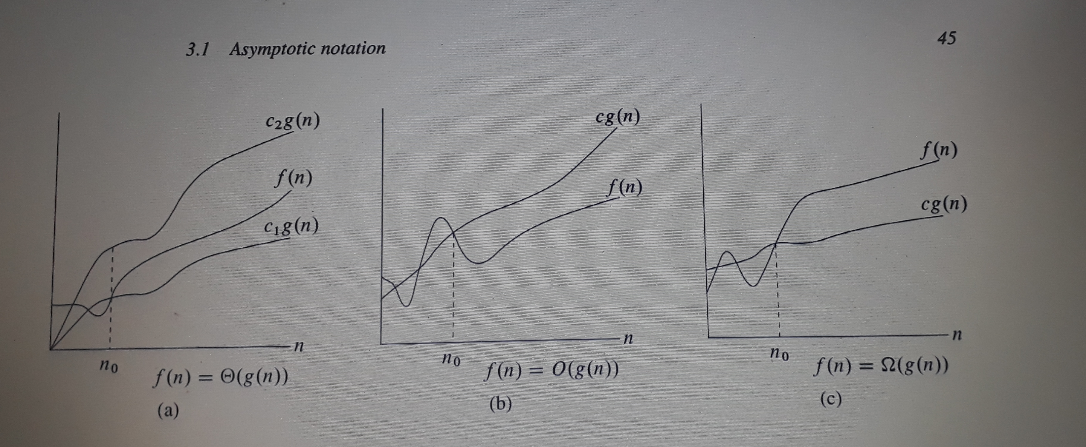



O-Notation (Big O Notation)
O (g(n)) = { f(n) : there exist positive constants c and n0 such that 0 <= f(n) <= c g(n) for all n >= n0

Slide 5







Let f(n) = ½ n² – 3n
We need to find constant c such that f(n) <= c n²
So, ½ n² – 3n <= c n²
Dividing both sides by n²
½ – 3/n <= c
We can make the inequality hold by taking a constant c >= ½ and n >= 1

Slide 6











If f(n) is a polynomial of order k, then f(n) = O (n^{k})
Example: f(n) = 4n³ + 3n²+ 10
Big O notation is not asymptotically tight
Let f(n) = 3 n²
Then, f(n) = O (n²)
Also, f(n) = O(n³)
O(1) means constant time that is the time does not depend on size of input or size of output

Slide 7












Θ Notation
Θ(g(n)) = { f(n) : there exist positive constants c₁, c₂ and n₀ such that 0 <= c₁ g(n) <=f(n) <= c₂ g(n)
Let f(n) = ½ n² – 3n
We want to check whether f(n) = Θ (n²)
We need to find constant c₁, c₂ such that 0 <= c₁ n² <= f(n) <= c₂ n²
So, ½ n² – 3n <= c₂ n²
Dividing both sides by n²
½ – 3/n <= c
We can make the inequality hold by taking a constant c >= ½ and n >= 1

Slide 8











Now,
c₁ n² <= ½ n² – 3n
Dividing by n², we get
c₁ <= ½ - 3/n
This inequality can be made to hold by taking n >= 7 and c <= 1/14
So, the given f(n) is Θ (n²)

Slide 9






ꭥ Notation (Big Omega Notation):
ꭥ(g(n))= { f(n): there exist positive constants c and n0 such that 0 <= c g(n) <= f(n) for all n >= n0
Best Case
Worst Case
Average Case

Slide 10








































Linear Search in Array

Slide 11




















Slide 12



















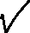












An example: (Multiplication of matrix A[n x n] and matrix B [ n x n ]
Input: matrices A and B
Let C be a new matrix of the appropriate size
For i from 1 to n:
For j from 1 to n:
Let sum = 0
For k from 1 to n:
Set sum ← sum + A_{ik} × B_{kj}
Set C_{ij} ← sum
Return C

Slide 13
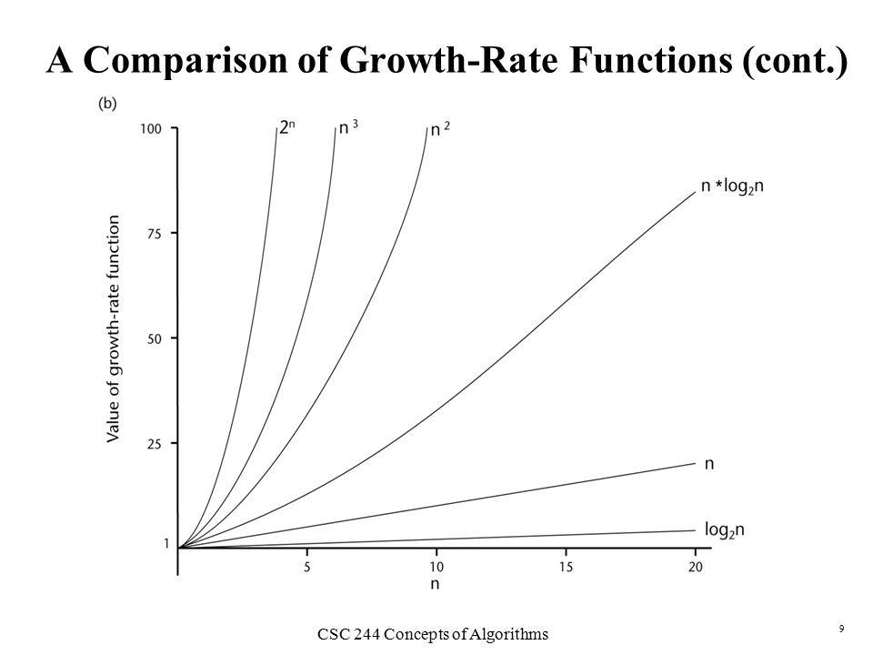












Slide 14
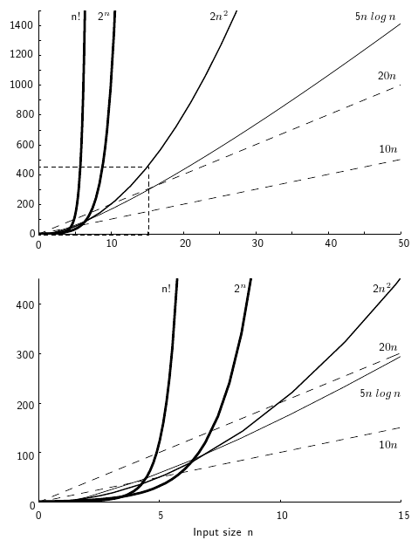


Slide 15
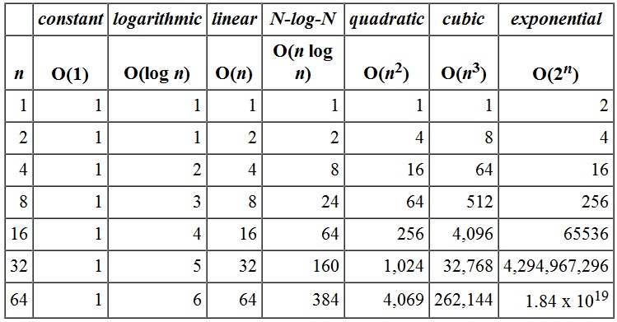



Slide 16
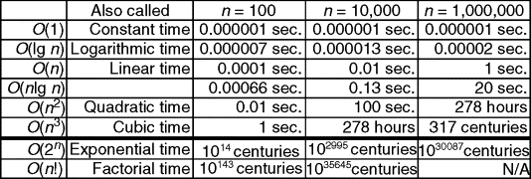

Slide 17


























































Slide 18












































Slide 19









































































Slide 20































































